Slide 1
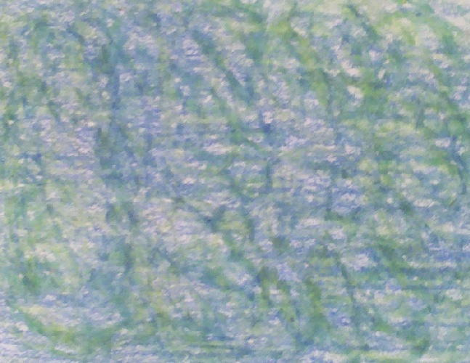
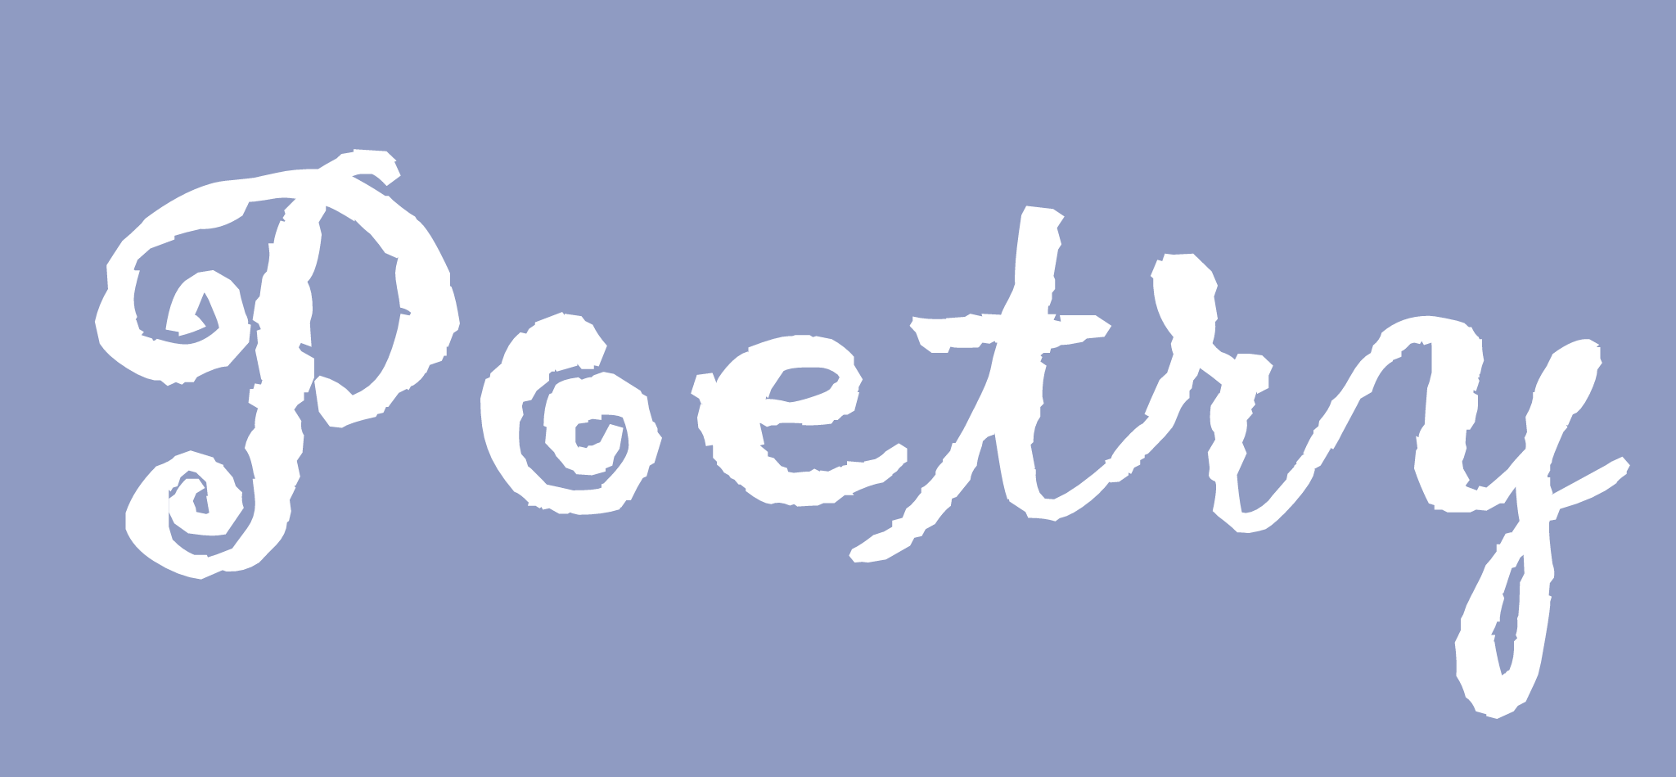

Slide 2
What is poetry?
Poetry is an imaginative awareness of experience expressed through meaning, sound, and rhythmic language choices so as to evoke an emotional response.
What does that mean?????
Poetry is a type of writing that is the language of imagination, of feelings, of self-expression…it makes the reader have emotional thoughts about what the author has written. Poetry is usually written in verses.

Slide 3
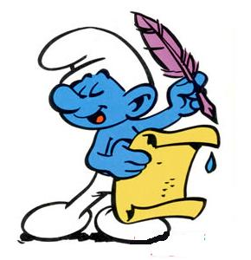
Poetry ~ Eleanor Farjeon
What is Poetry? Who Knows?
Not a rose, but the scent of the rose;
Not the sky, but the light in the sky;
Not the fly, but the gleam of the fly;
Not the sea, but the sound of the sea;
Not myself, but what makes me
See, hear, and feel something that prose
Cannot: and what it is who knows?
(*from Eleanor Farjeon's Poems for Children,1938)
Poetry is thoughts that breathe, and words that burn. ~ Thomas Gray
A poem begins as a lump in the throat, a sense of wrong, a homesickness, a lovesickness ... It finds the thought and the thought finds the words. ~ Robert Frost

Slide 4

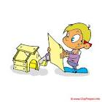
“I’m Building…Something”
Bottle tops and rubber bands,
Empty boxes, varied brands.
Plastic tubs and sticky tape,
Last Halloween's black Vampire cape.
Cardboard tubes and burst balloons,
Assorted bent and broken spoons.
Three magazines, my sister's shoes,
(I took them whilst she had a snooze.)
My winter gloves, a paper bag,
A flapping pirate castle flag.
A pot of glue, some old pen tops,
And two of my mum's kitchen mops.
A pile that's twice as high as me,
A diverse heap, as you can see.
I scratch my head as I begin,
What was I going to build again?
©2005 Gareth Lancaster

Slide 5
My Parents Sent Me To the Store
My parents sent me to the store
to buy a loaf of bread.
I came home with a puppy
and a parakeet instead.
I came home with a guinea pig,
a hamster and a cat,
a turtle and a lizard
and a friendly little rat.
I also had a monkey
and a mongoose and a mouse.
Those animals went crazy
when I brought them in the house.
They barked and yelped and hissed
and chased my family out the door.
My parents never let me
do the shopping anymore.
--Kenn Nesbitt
Click here to listen to and to watch video of poem
Copyright © 2011 Kenn NesbittAll Rights Reserved

Slide 6
School Supplies
Backpack.
Fruit snack.
Water bottle too.
Calculator.
French Translator.
Pink eraser.
Glue.
Notebooks.
Workbooks.
Poster paper.
Pens.
Dictionary.
Stationery.
Presents for my friends.
Lunchbox.
Tube socks.
Watercolors.
Tape.
Yellow pencils.
Plastic stencils.
One for every shape.
Wristwatch.
Stopwatch.
Cell phone.
DVD.
New computer.
Motor scooter.
Giant screen T.V.
That's my
list of
all I need to buy.
I never knew
a shopping list
could make my mother cry.
--Kenn Nesbitt
Copyright © 2007 Kenn Nesbitt
All Rights Reserved
Click here to listen to poem.

Slide 7

Types of Poems
(we will be studying)

Slide 8

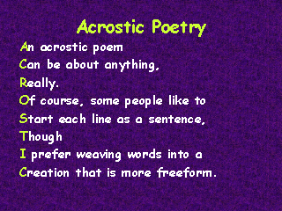
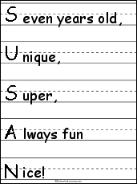
Acrostic Poem
Create Own
An acrostic poem is a form of poetry in which the letters of the title serve as the initial letters of each line of the poem.
BABY
Bright little tot
Always
Blissfully
Yawning and eating.

Slide 9

Couplets
Couplets are made of two-line stanzas that rhyme.
Friends
My friends are fun to have around
Except when they stomp their feet and frown.
My friends like to bother boys
But I’d rather play with toys!
My friends like to ride the bike
But I’d rather take a hike.
But that’s okay
We’re friends anyway!
~Breanne Franey
Music
Voice of instruments fill the air
Sounds of music everywhere.
The violins sing
As the tambourines ring.
~Kelly Meyer

Slide 10
Haiku
Haiku is a single thought expressed in three non-rhyming lines. The first line has 5 syllables, the second has 7 syllables, and the third line has 5 syllables.
Sweet smells fill the air
Flowers blooming everywhere
Babes born here and there
~Ashley Daniel
Little hungry frog
Resting on a lily pad
Dreams of careless flies

Slide 11
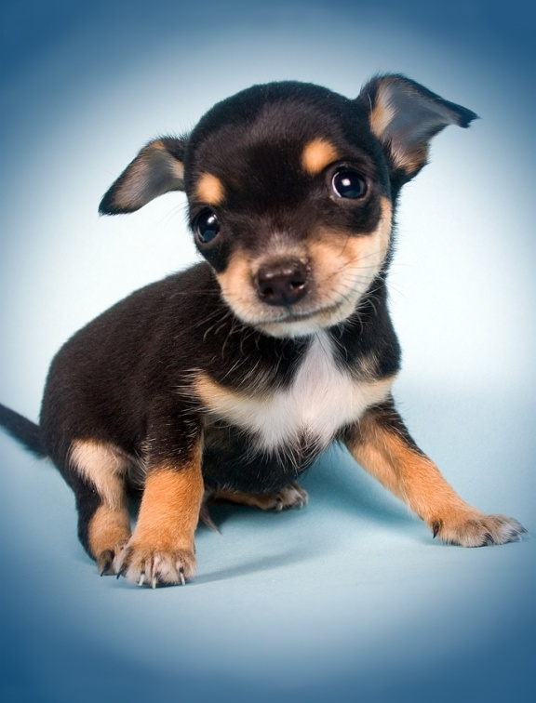
Cinquain
A cinquain is a five-line poem. Traditional Cinquains follow a syllable count, while a simpler version follows a word pattern.
Puppy
Soft, furry
Wiggles in sleep
Dreaming of lost bones
Pet
Trumpet
Golden, gleaming
Puckering, puffing, blowing
Mean machine
Bronze flower
~Joel Griffin

Slide 12

Diamonte Poetry
Diamonte poetry shows change. The beginning line and the last line are opposites or contrasting words. The poem shows a gradual change from the first line to the last line. It is written in the shape of a diamond.
Tears
ache, grief
drops, water, pleasure, grin
celebrated, laughed, cheered
delight, joy
Smiles
Jo Ellen Moore

Slide 13


Limericks
A limerick is an amusing verse of five lines. Lines 1, 2, and 5 rhyme and lines 3 and 4 rhyme. Line 5 refers back to line 1. Lines 3 and 4 are usually shorter than the other lines.
There once was an alligator named Cicilia
If you ever saw her it would chill ya.
She wore a hat.
She was so fat.
She was always trying to kill-ya.
Chris Castro

Slide 14
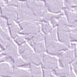
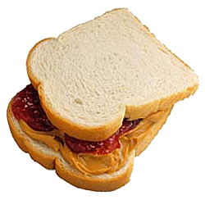
There once was a student named Sam
Who loved peanut butter and jam.
This snack is the best
It tops all the rest
Reported that fellow named Sam.

Slide 15
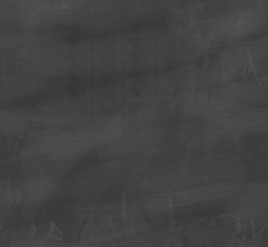

The End!!

